Slide 1
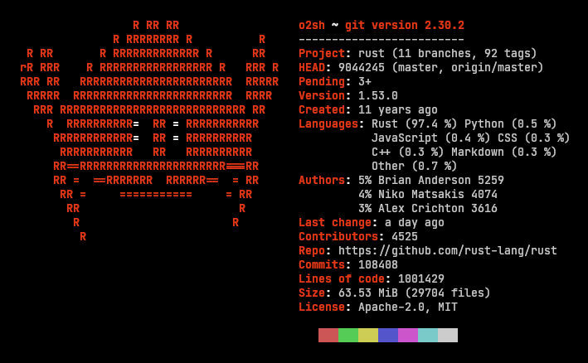
Rust
Programming
Language
BIOE5060-Computing Skills for Bioengineers
Professor Qianqian Fang
Hedieh Karimitar

Slide 2

Outline
Rust Introduction
Rust Data types
Rust Input/Output
Rust Variables
Rust Operators
Rust Loop
Rust Functions
Rust Modules
Rust Array
Rust File input/output

Slide 3
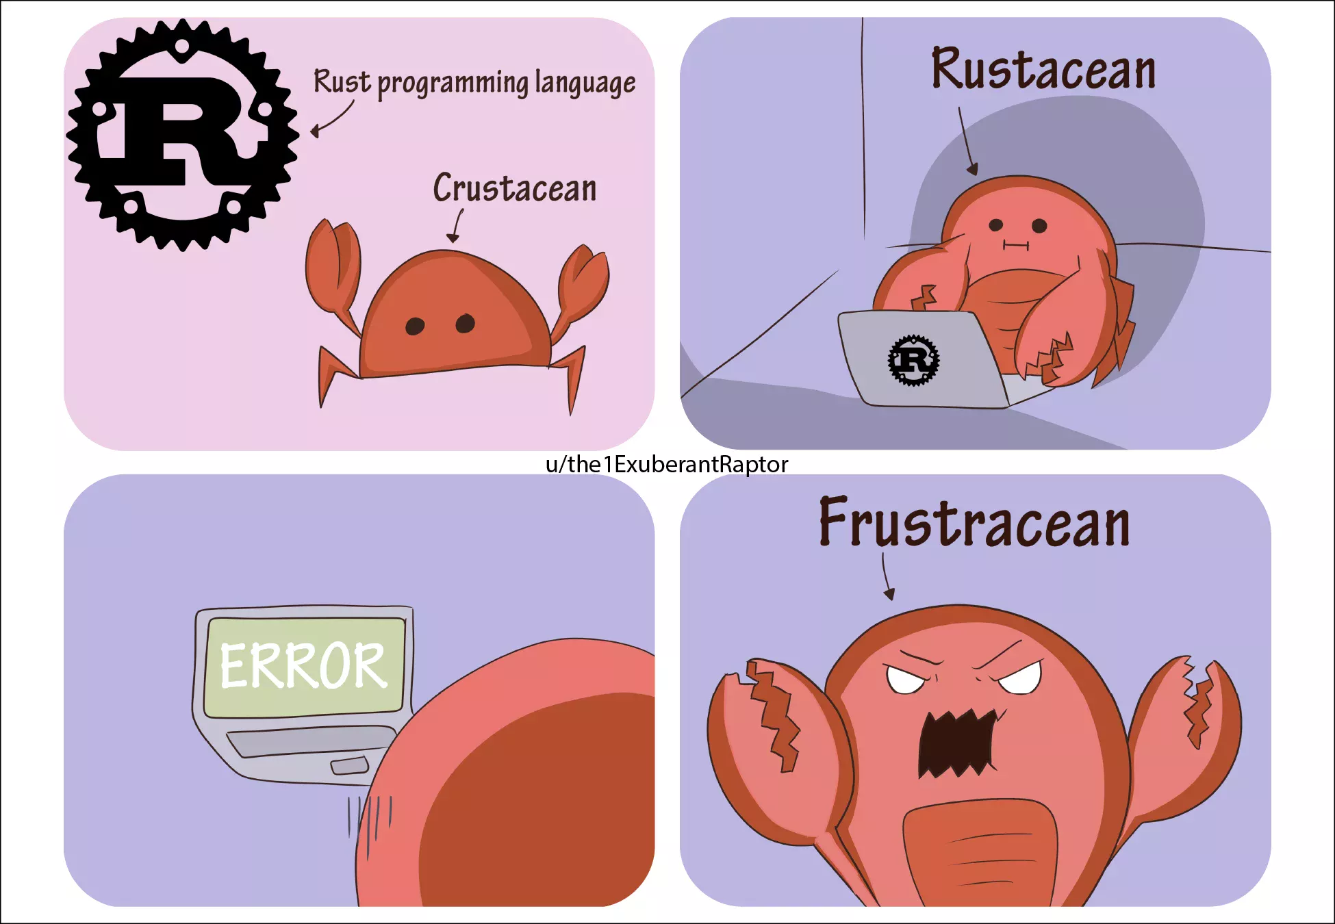
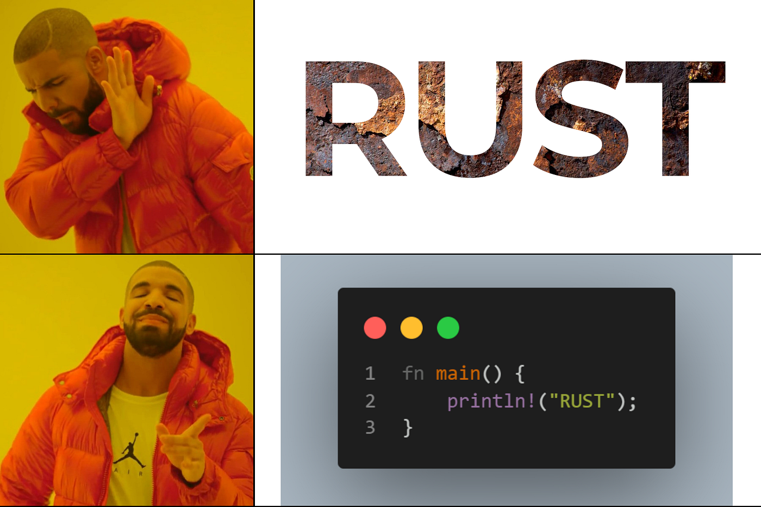
Introduction
Rust is a modern systems programming language developed by the Mozilla Corporation. It is intended to be a language for highly concurrent and highly secure systems. It compiles to native code; hence, it is blazingly fast like C and C++.
Rust is a systems level programming language, developed by Graydon Hoare. Mozilla Labs later acquired the programme.

Slide 4

Why Rust?
Rust focuses on three goals:
Safet
Speed
Concurrency
The language was designed for developing highly reliable and fast software in a simple way. Rust can be used to write high-level programs down to hardware-specific programs.
Key Use Cases
Performance
Memory safety at compile time
Multi-threaded applications
Support for Web Assembly (WASM)

Slide 5
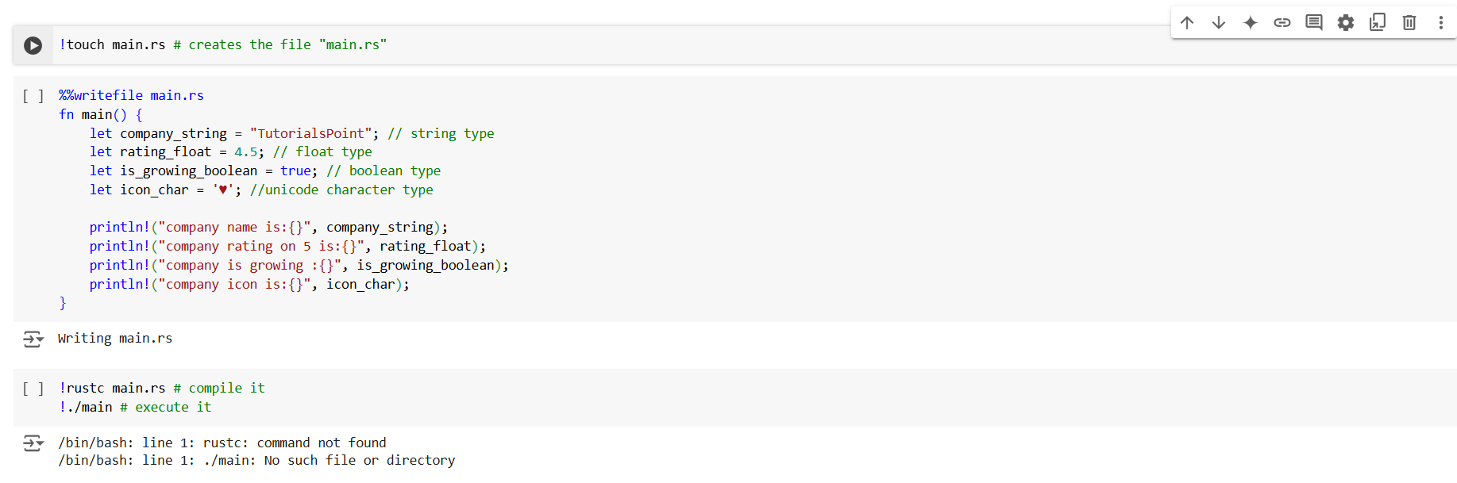
Rust - Data Types
Rust is a statically typed language. Every value in Rust is of a certain data type. The compiler can automatically infer data type of the variable based on the value assigned to it.

Slide 6
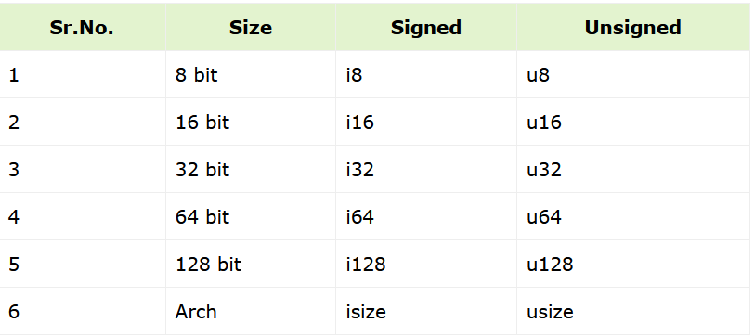
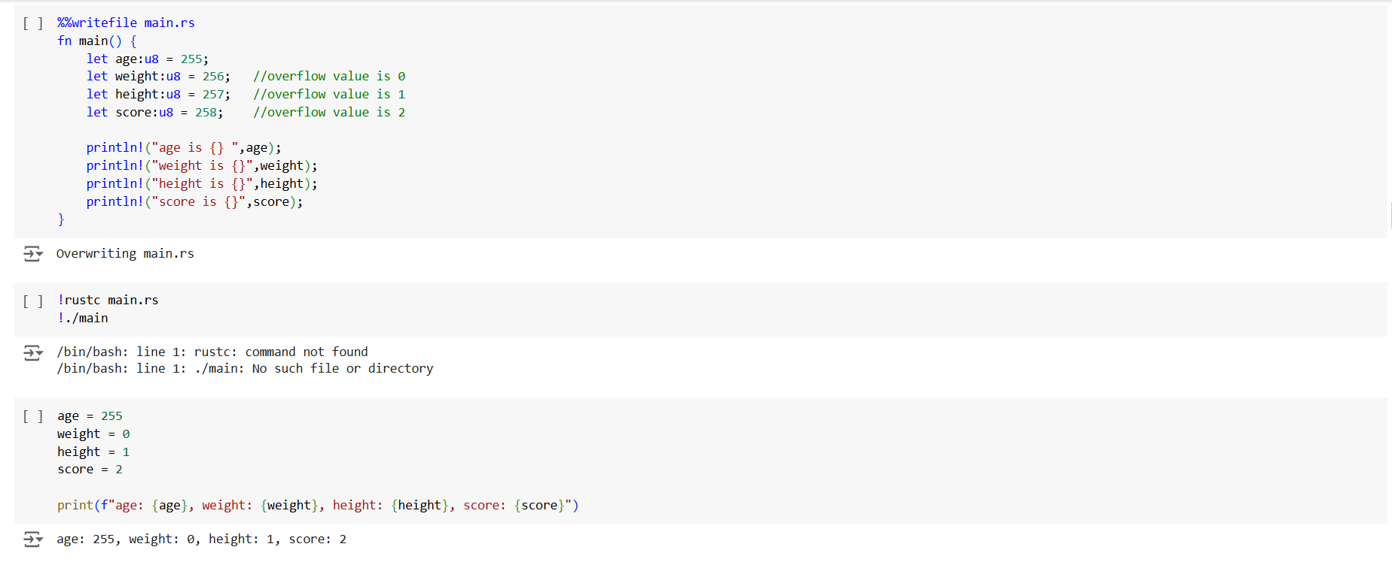
Scalar Types
Scalar Types
A scalar type represents a single value. For example, 10,3.14,'c'. Rust has four primary scalar types.
Integer
Floating-point
Booleans
Characters

Slide 7





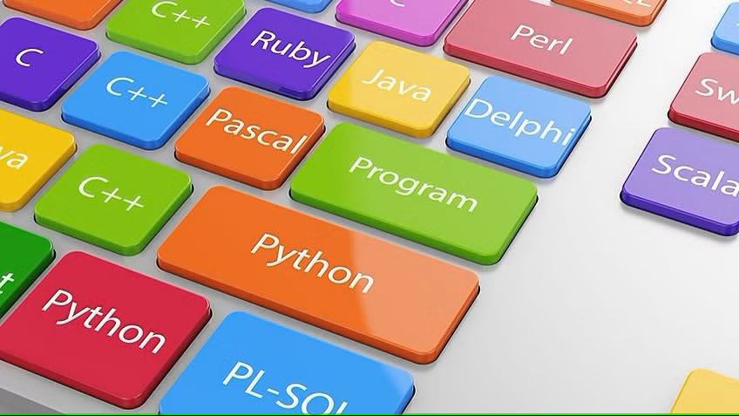












Rust-Variables
A variable is a named storage that programs can manipulate. Simply put, a variable helps programs to store values. Variables in Rust are associated with a specific data type. The data type determines the size and layout of the variable's memory, the range of values that can be stored within that memory and the set of operations that can be performed on the variable.
Rules for Naming a Variable
In this section, we will learn about the different rules for naming a variable.
The name of a variable can be composed of letters, digits, and the underscore character.
It must begin with either a letter or an underscore.
Upper and lowercase letters are distinct because Rust is case-sensitive.

Slide 8
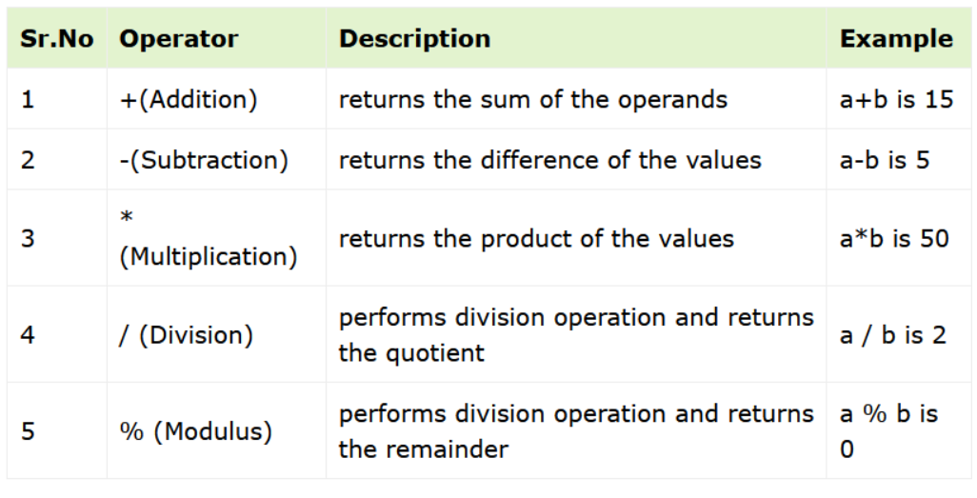
Rust-Operators
An operator defines some function that will be performed on the data. The data on which operators work are called operands. Consider the following expression: 7 + 5 = 12
Here, the values 7, 5, and 12 are operands, while + and = are operators.

Slide 9
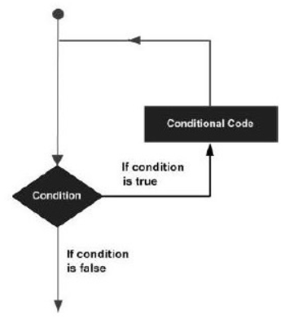
Rust-Loop
There may be instances, where a block of code needs to be executed repeatedly. In general, programming instructions are executed sequentially: The first statement in a function is executed first, followed by the second, and so on.
Programming languages provide various control structures that allow for more complicated execution paths.
A loop statement allows us to execute a statement or group of statements multiple times. Given below is the general form of a loop statement in most of the programming languages.

Slide 10
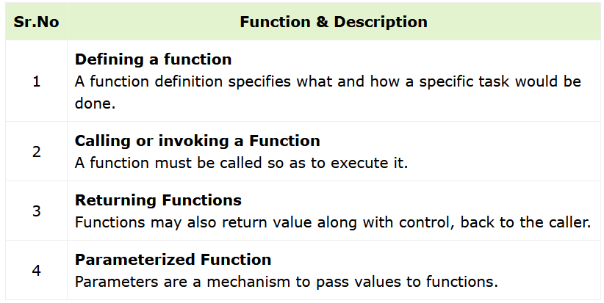
Rust-Functions
Functions are the building blocks of readable, maintainable, and reusable code. A function is a set of statements to perform a specific task. Functions organize the program into logical blocks of code. Once defined, functions may be called to access code. This makes the code reusable. Moreover, functions make it easy to read and maintain the program’s code.
A function declaration tells the compiler about a function's name, return type, and parameters. A function definition provides the actual body of the function

Slide 11
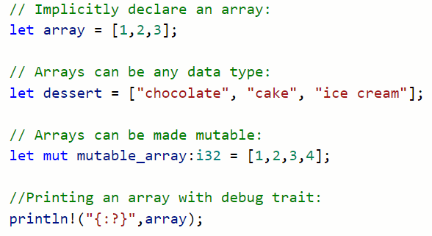
Rust-Array
Variables are scalar in nature. In other words, a variable declaration can only contain a single value at a time. This means that to store n values in a program n variable declaration will be needed. Hence, the use of variables is not feasible when one needs to store a larger collection of values.
Variables in a program are allocated memory in random order, thereby making it difficult to retrieve/read the values in the order of their declaration.

Slide 12

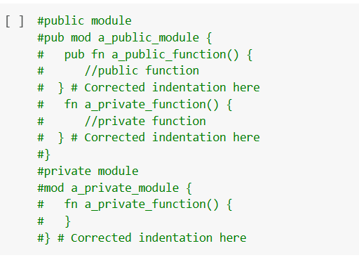
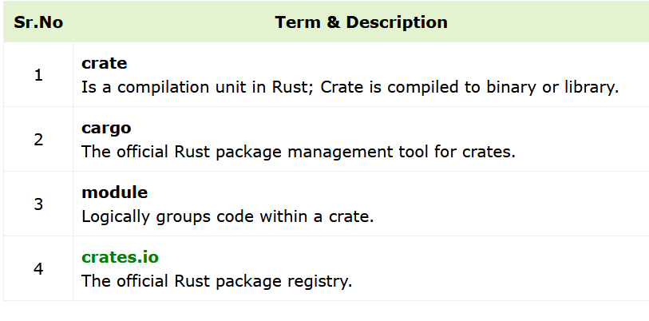
Rust-Modules
A logical group of code is called a Module. Multiple modules are compiled into a unit called crate. Rust programs may contain a binary crate or a library crate. A binary crate is an executable project that has a main() method.

Slide 13
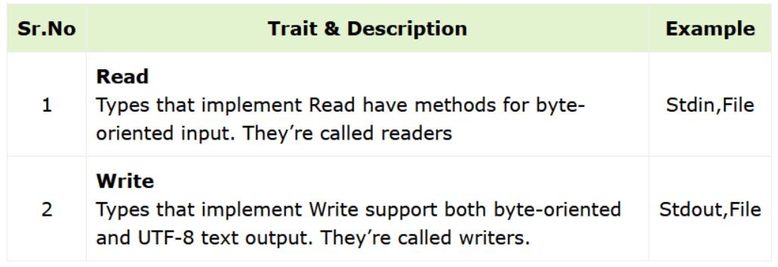
Rust-Output/Input
Rust’s standard library features for input and output are organized around two traits:
Read
Write
Read Trait
Readers are components that your program can read bytes from. Examples include reading input from the keyboard, files, etc. The read_line() method of this trait can be used to read data, one line at a time, from a file or standard input stream.
Write Trait
Writers are components that your program can write bytes to. Examples include printing values to the console, writing to files, etc. The write() method of this trait can be used to write data to a file or standard output stream.

Slide 14
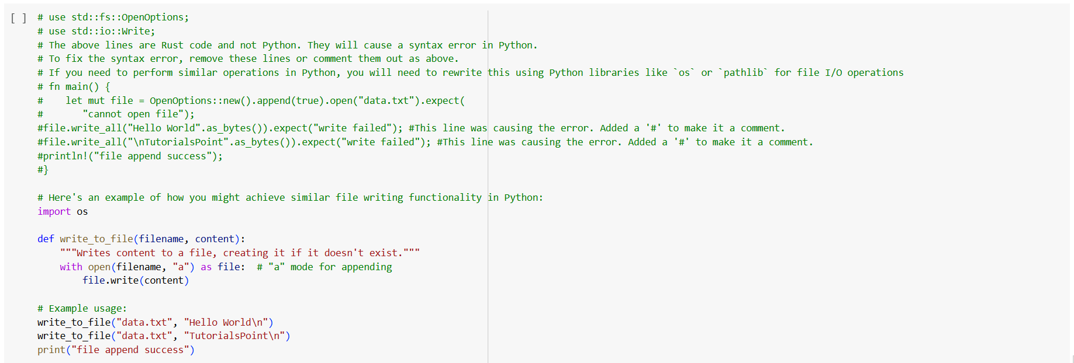
Rust-File Input/Output
In addition to reading and writing to console, Rust allows reading and writing to files.
The File struct represents a file. It allows a program to perform read-write operations on a file. All methods in the File struct return a variant of the io::Result enumeration.
The commonly used methods of the File struct are listed in the table below:

Slide 15


